Slide 1

Zoning Bylaw Amendment – Cottage Overlay District
Article 30

Slide 2
Article 30
What
Add new Zoning Bylaw Section 11.7: Cottage Overlay District
Why
Provide opportunities for compact and attainable housing
Accommodates a range of residents at different life stages
First-time homebuyers
Families
Older adults
Within walking distance of shopping, local services, community venues and public transportation
Promotes housing diversity and sustainable development
Notes:
The purpose of the Cottage Overlay District (COD) is to provide opportunities for compact and attainable housing that accommodates a range of residents at different life stages, including first-time homebuyers, families, and older adults wishing to age in place. It is intended to be applied to locations that are within walking distance of a range of shopping, local services or community venues and public transportation. This district promotes housing diversity and sustainable development.
https://www.mma.org/wp-content/uploads/2019/02/starter_homes_how_to_welcome_new_homeowners_annualmtg19.pdf

Slide 3
Cottage Overlay District (COD)
Article 30
Overlay zoning district, superimposed over the underlying zoning district(s)
Either the COD provisions set forth in this section
Or the provisions applicable to the underlying Zoning District
Cottage home projects
Subject to site plan approval by Planning Board
Follow design & sustainable development standards
Notes:
Pine Hill Crossing (former Coast Guard Property):
The max density is 6 units per acre.
29 total units
26 are 3 BR
1 is 2 BR
2 are 1 BR.
The 12 original ranches built in 1958 are 1,189 SF
all but 1 are 3 BR (one was converted to 2 BR)
15 of the 17 new units are 1,356 SF with 3 BRs.
2 of the new units are 819 SF with 1 BR.
Other zoning parameters of interest: max unit size is capped at 1,500 SF; max height = 26’ and 2 stories

Slide 4
COD Design Standards
Article 30
Front pedestrian entrance must face closest street / access drive
Pitched roofs
Universal Design
Grab bars around toilets/tubs/showers
Door openings: 32” to 48”
No raised interior thresholds (unless required by law)
Minimize steps necessary to access dwelling to one step
Can be waived by the Planning Board
Notes:
Bedford is committed to ensuring that quality housing is accessible to people of all ages, abilities, and income levels.
Units constructed or renovated specifically to be fully accessible shall meet ADA standards for accessible design.
Goal: trying to ensure the houses have a reasonable level of visitability and adaptability for people with mobility difficulties
rule about the minimum number of inches from the ground next to the foundation to the bottom of the siding:
Section R317.1 of the 10th edition of the MA State Building Code. It used to be 8” but referencing it just now, it is 6”. When referencing this section it states protection of wood and wood-based products from decay shall be done in 9 situations and number 6 reads:
Wood siding, sheathing and wall framing on the exterior of a building having clearance of less than 6” from the ground or less than 2” measured vertically from concrete steps, porch slabs, patio slabs and similar horizontal surfaces exposed to the weather.
That’s to reduce the risk of insect penetration. feasible to have one step and a slightly raised landing area accessed by a slightly sloped path
landing could just be a concrete slab setbacks for landings reduced (if they were near the perimeter of the lot)
also have the waiver provision for the step rule if there were difficulties in a particular case

Slide 5
COD Sustainable Development Standards
Article 30
Sustainable Development
Energy efficiency
Environmental protection and stormwater management
Low impact development
Notes:
Sustainable Development. Cottage Home Projects should incorporate best practices in energy efficiency, environmental protection and stormwater management, as well as Low Impact Development site design components. At a minimum, each Cottage Home Project shall satisfy at least two of the following sustainable development standards, provided that other comparably sustainable standards may be substituted upon approval of the Planning Board in its review for Site Plan Approval

Slide 6
COD Sustainable Development Standards, con’t.
Article 30
Minimum of 2 of the following:
Use of pervious materials in lieu of impervious materials
Minimum 20% of total area that would be impervious must be pervious
Incorporation of green space within cul-de-sacs and boulevard islands
Passive house design features
Avoidance of fossil fuel HVAC systems & appliances
Incorporation of rain gardens, bioswales, non-structured stormwater controls
Clustering dwelling units to preserve open space
Notes:
Sustainable Development. Cottage Home Projects should incorporate best practices in energy efficiency, environmental protection and stormwater management, as well as Low Impact Development site design components. At a minimum, each Cottage Home Project shall satisfy at least two of the following sustainable development standards, provided that other comparably sustainable standards may be substituted upon approval of the Planning Board in its review for Site Plan Approval

Slide 7
COD Further Development Standards
Article 30
Plantings
Trees and shrubs must be provided in setbacks and within development
At least one tree required per dwelling unit (new or existing)
Minimum of 70% trees and shrubs native
No invasive species allowed
Minimum of 70% of trees must be shade trees

Slide 8
COD Further Development Standards, con’t.
Article 30
Parking
Each home must be provided with off street parking space(s)
No more than one garage space per unit
At least one securable bicycle parking or storage space per dwelling unit
Garage satisfies this requirement

Slide 9
COD Dimensional & Density Standards
Article 30
Minimum Lot Area of Development Locus (sq. ft) | 40,000
Maximum Height Stories Feet | 2 30
Maximum Density | 10 dwelling units per acre
Maximum Unit Size | 1,850 sq. ft. gross floor area (excl. garage space)
Minimum Lot Frontage (ft) | 150
Minimum Front Yard Setback (ft) | 20
Minimum Side Yard Setback (ft) | 15
Minimum Rear Yard Setback (ft) | 15
*Preexisting residential structures shall not be subject to setback and height requirements, but shall comply with lot area, density, and unit size requirements
Notes:
Normal Height: 3 stories / 35 feet
MBTA Housing: 15 units / acre
Preexisting residential structures shall not be subject to setback and height requirements of Table 11.7-1 but shall comply with lot area, density, and unit size requirements. Unenclosed entry stairs and landings shall have a minimum Side Yard Setback of 10 feet.
Unenclosed entry stairs and landings shall have a minimum Rear Yard Setback of 10 feet.

Slide 10
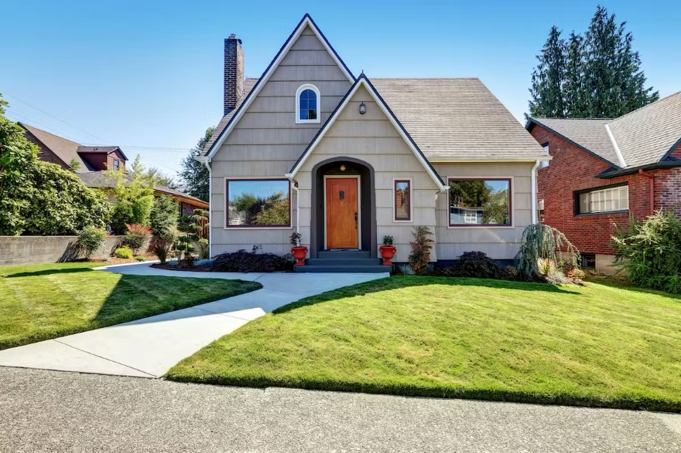
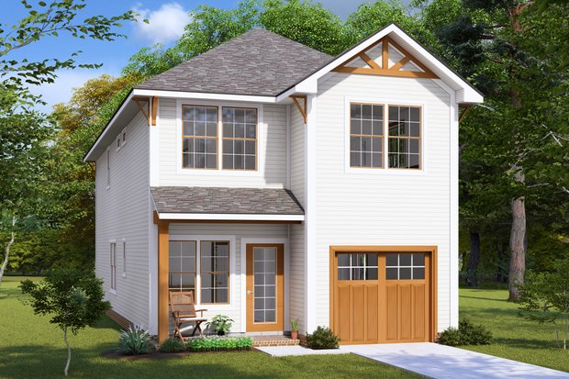
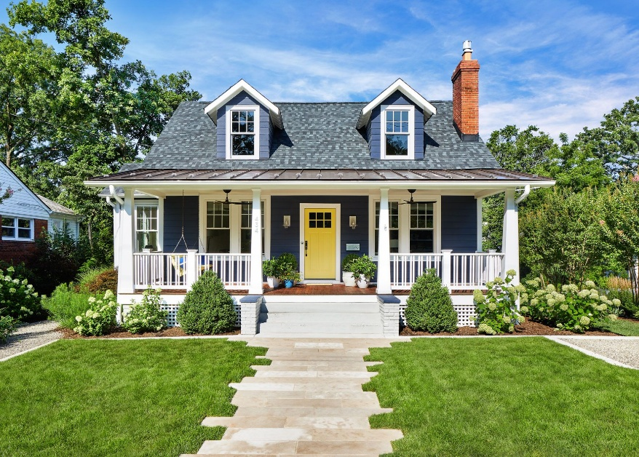
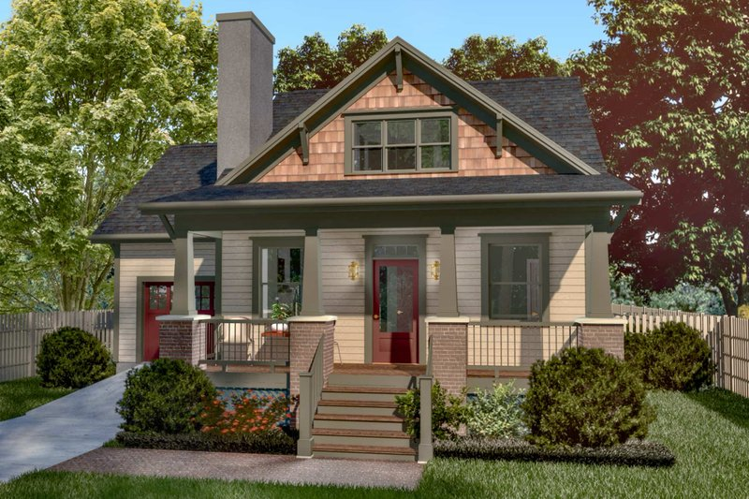
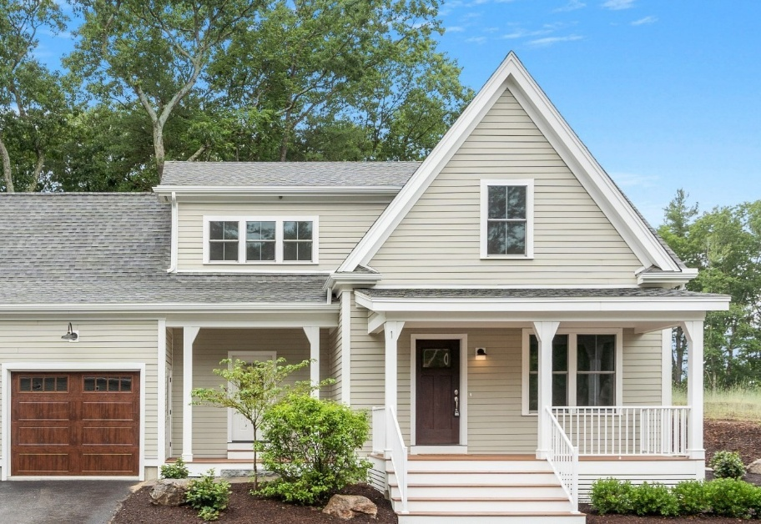
Cottage Home Examples
Article 30

Slide 11
Zoning Map Amendment –Cottage Overlay District
Article 31
Notes:
EXPLANATION: This article would amend the Zoning Map to identify 49 Elm Street as being designated in a Cottage Overlay District, should the prior article Cottage Overlay District be approved. This article only requires a simple majority under State Laws promoting housing production.
Zoning Map Amendment to apply COD to 49 Elm Street
Center of Town
Proposal initiated by a resident of town
Apply in other areas might have different density
Spot Zoning – reason: logic, considered broadly, serving public purpose

Slide 12
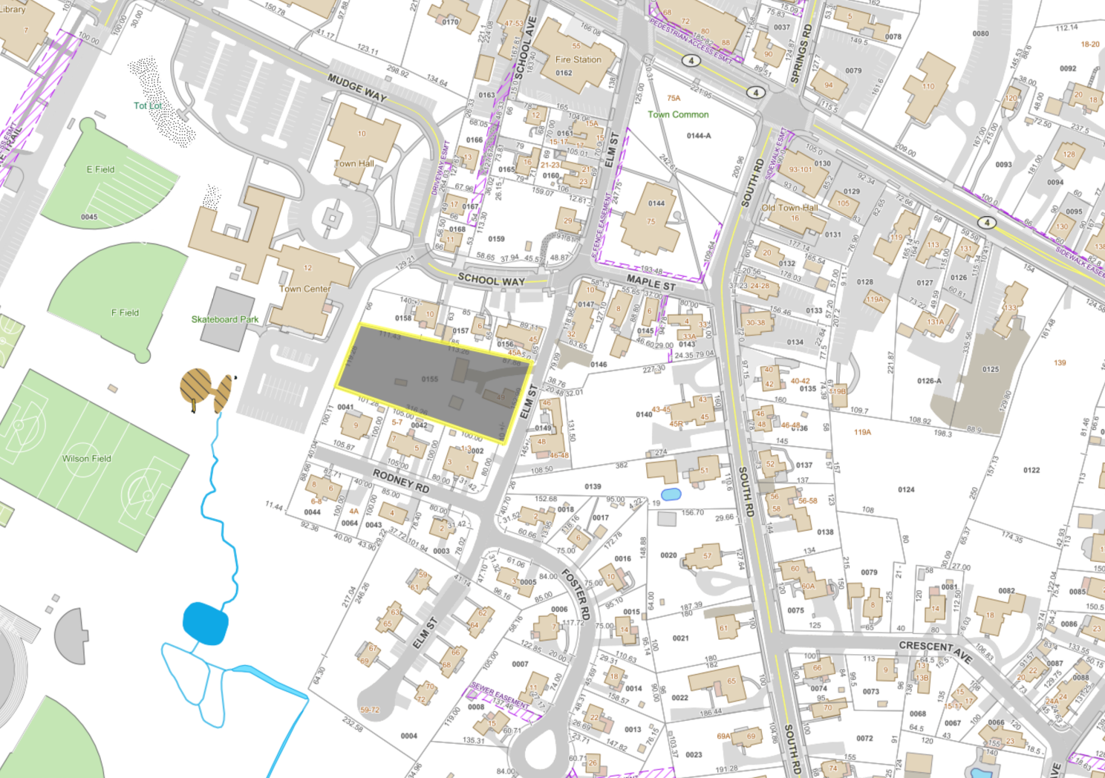
Cottage Overlay District Initial Location 49 Elm Street
Article 31
Notes:
the ball fields
the 1st parish church/town common

Slide 13
Cottage Overlay District Zoning Map- 49 Elm Street
Article 31

Slide 14
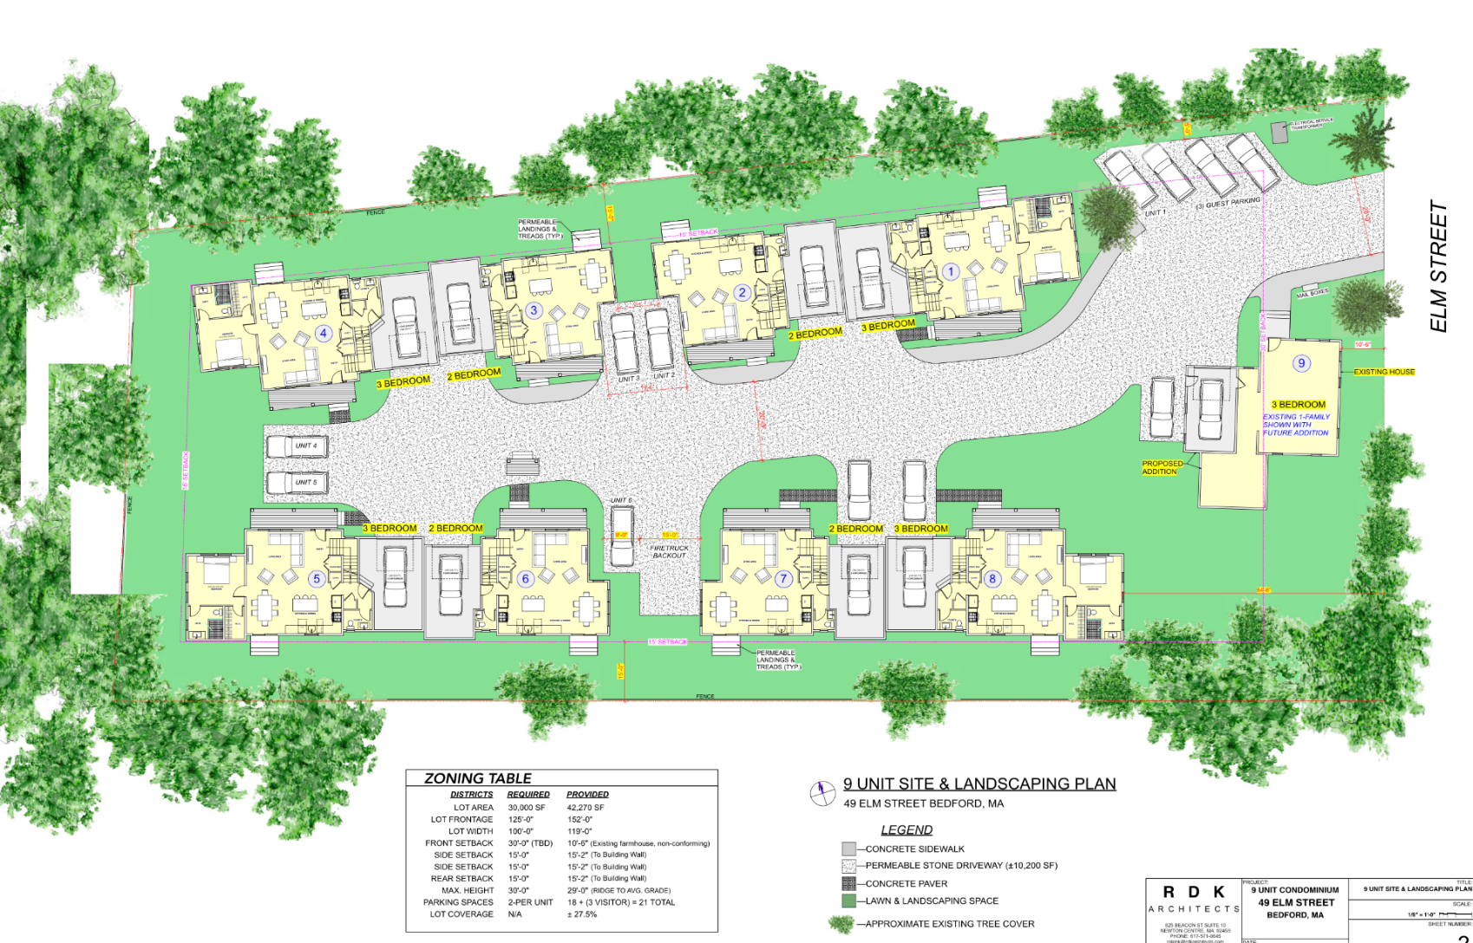
Conceptual Development Site Plan
Article 31

